Slide 1
Content Boosted Collaborative Filtering with WARP Loss for Medical Diagnosis with Patient Data
Yu Fung David Wang

Slide 2
Quick Timeline
Preliminaries
Results and Future Directions
01
02
03
04
Quick Recap and Problem
Technical

Slide 3
Recap on Recommender Systems
RS
CF
CBF
Recommender System
Collaborative Filtering
Content Based Filtering
Information filtering system to predict user preferences
Netflix and Amazon
”People who have agreed in the past tend to agree in the future”
Collect information from users from feedback to make automatic predictions
User-based CF rating: compares user ratings to predict rating for new user
Identify items/users via item/user descriptions/features
Solves cold-start problem
Notes:
RS: It is a information filtering system that predicts user preferences that a user gives to an item. User preferences can come in the shape of ratings, checkins, reviews, and more. Essentially, RS works to get these user preferences in order to make recommendations. Some popular RS systems include movie recommendations from Netflix and product recommendations from Amazon.
CF: Relies on fact user preferences are stable and based on premise of “people who have agreed in the past tend to agree in the future”. As such, it works by taking user information built on user and item feedback and making predictions.
For example, in user-based CF of a rating system, it compares user ratings on the same item to predict ratings for a new user on the item.
CBF: identify items or users via item description or features instead of relying just on user feedback. As user feedback is not always present in the cold-start problem, it alleviates the problem by generating items or users based on features. Just as a reminder but the cold start problem is when there are new items or users that have none or little previous interactions so they cannot be categorized to generate recommendations.

Slide 4

Problem Formulation
RS commonly used for commercial means
Movie recommendations
Product recommendations
HRS are less explored
Medical diagnosis not explored as much
Sparsity, cold-start, privacy from unpredictability, differentiating cases between individuals, privacy of patient data.
CBCF and FairGRecs
Notes:
As mentioned earlier, RS is currently in use mainly for commercial purposes such as that of Netflix and Amazon.
On the other hand, RS have not been extensively researched in the domain of healthcare.
Health Recommender systems have been used for certain recommendations such as medicine recommendation, food recommendation, and recommendations to types of hospitals.
However, medical diagnosis via RS has not been explored too much.
Some specific reasons for this may be due to the sparsity, cold start, and privacy issues of patient data. To be more specific, patient data suffer from unpredictability of user profiles, differentiating cases between individuals, and weariness of privacy attacks. As such, the popular RS methodologies of CF and CBF are insufficient in protection against the cases.
Thus, a combination of CF and CBF into a CBCF mechanism would prove vital to prevent the cases of data sparsity and cold start. Furthermore, synthetic datasets such as that of FairGRecs would provide a naïve solution to certain privacy attacks.

Slide 5
Preliminaries
CF Algorithms
CBCF Algorithm
Co-Cluster, kNN, SVD
LightFM
Latent representation
Linear combinations
Commercial
Health
MovieLens and StackExchange
MovieLens: sparse
StackExchange: cold
FairGRecs
Built by EMRBots of 10 thousand artificial patients
Patient ratings
Notes:
First, the CF algorithms that were utilized as baseline algorithms included co-cluster, k nearest neighbors, and singular value decomposition. For the sake of time, these models will not be fully explained here but in the paper, they will be.
The model being tested is a CBCF algorithm that was implemented through the LightFM package. As a short summary, this model implements latent representation of users and items and this model represents the latent vectors of users and items as linear combinations of their features. More on this will be in the technical slide
Furthermore, commercial datasets including movielens and stackexchange were used as baselines to test the other domains. Movielens is a dataset that is composed of user ratings towards movie titles. Stackexchange is a dataset that is composed of votes towards expert answers to questions asked on the popular stackoverflow website.
These two datasets have their unique characteristics including how movielens mimics a real dataset and thus is made up of a very sparse matrix as the number of zero entries far exceeds number of actual entries. Stackexchange, on the other hand, suffers more from the cold start problem as there is a lack of interactions between users and questions.
Finally, the dataset in the health domain that will be utilized is known as fairgrecs. This dataset is a synthetic dataset build by EMRBots to create domcuments of 10 thousand artificial patients. This dataset includes patient ratings towards diseases and symptoms.

Slide 6
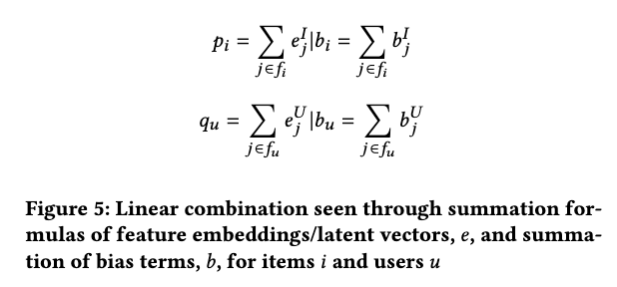
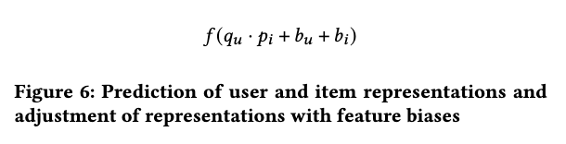
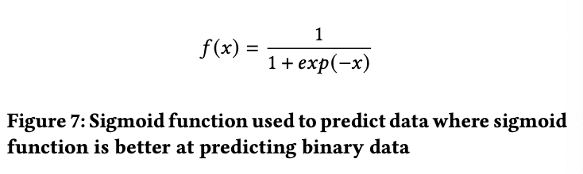
Technical Design
Weighted Approximate—Rank Pairwise (WARP)
LightFM (CBCF)
Loss approach to optimize classification metrics
Negative sampling technique with SGD
WARP loss function and SGD sample negative items to rank and generate feature embeddings
CF: Generating latent vectors/embeddings
CB: linear combination of embeddings to describe users
Notes:
First, weighted approximate rank pairwise or WARP is utilized as the loss function. It utilizes a negative sampling technique. How it works is that it samples items at random to which once a negative item is found, which is an item the model found to not match the user, gradient updates are performed with Stochastic Gradient Descent to the model parameters such as users and items to correct the model so that the other items would be higher in rank than the found negative item. The rank of interaction between a particular target item and a user is the number of negative items that were sampled before reaching that target item.
From this WARP loss, it was utilized in the LightFM model of CBCF to generate feature embeddings which showed the rank of the user to item interaction given the item features. these feature embeddings or latent vectors were achieved, linear combination was performed by summing up the latent vectors. The feature biases were also summed up for future adjustment.
Then, a prediction was achieved by getting dot product of user and item representations and having the feature biases adjusted.
The result from this was the predicted rating of a item to a user and was inputted into a sigmoid function to map probability of occurrence of the predicted rating from 0 to 1

Slide 7
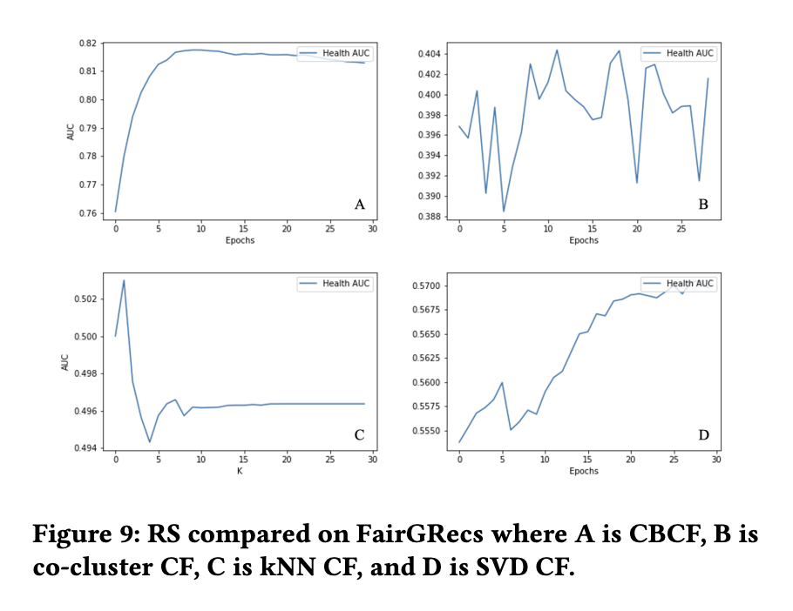
Comparison of Models
AUC
Good ranking metric to measure amount of correctly ranked items in C.V
Epochs
3 on epochs but kNN is on size of k
CBCF is the best
CBCF > SVD > kNN > co-cluster
Notes:
First, I used area under the curve because it was able to measure proportion of user-item pairs in proposed ratings that were identified correctly to be ranked higher than irrelelvant items in the user-item pair based on the actual dataset during cross-validation.
For the 4 tested models, 3 of them are ran on epochs while the kNN model was ran on the size of k to give a good estimate of which k produces the highest probability
It was found that CBCF produced the best results on the health dataset given its log growth with the highest AUC, followed by SVD, kNN, and then co-cluster.
This test shows the improvements that a hybrid model produces and the plausibility in using CBCF in the health domain

Slide 8
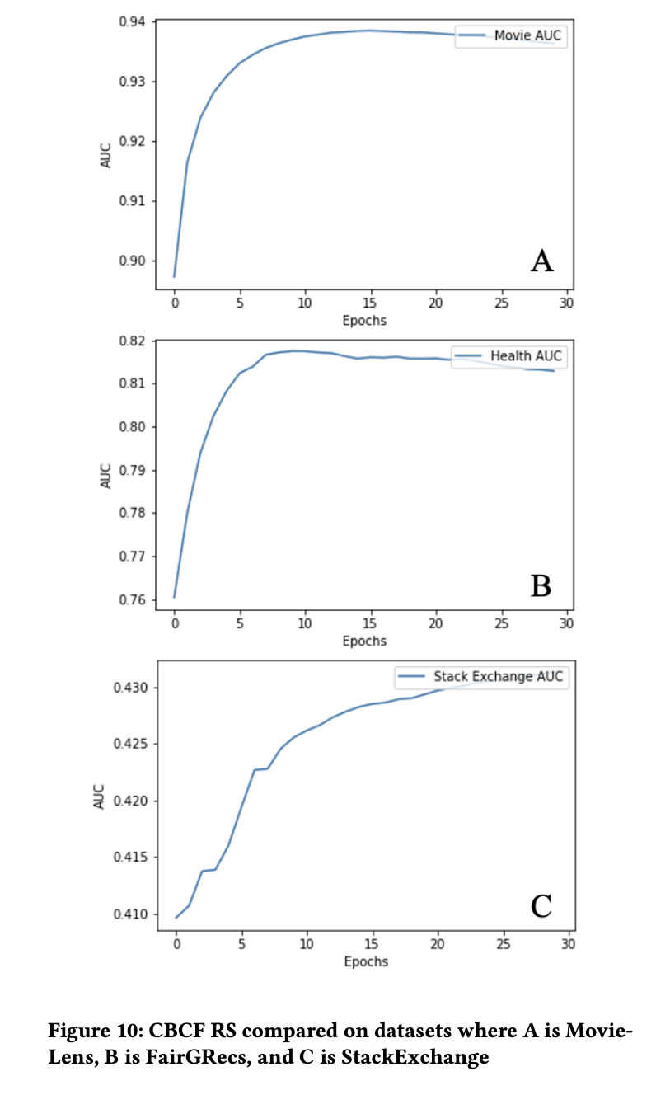
Comparison of Datasets
Recap
MovieLens: sparser, StackExch: colder
FairGRecs
Performed well in comparison
MovieLens is the best
MovieLens > Health > StackExch
Notes:
To break down the hybrid model further, ran it on different datasets.
To quickly recap, the movielens dataset had more sparse datapoints while the stackexchange dataset suffered from cold-start more
Health dataset performed well on average.
However, the movielens dataset performed the best. The Stackexchange dataset on the other hand, performed visibly worst than the rest. This can potentially be attributed towards the hybrid model not being completely optimized to deal with the cold-start issue. The health dataset, on the other hand, faltered with some AUC potentially because it also dealt with cold start.

Slide 9
Future Directions
Utilize deep learning architecture to enable exploitation of nonlinear combinations, along with linear combinations, of latent vectors to improve cold-start problem
Testing individual model parameters to see optimality as a health RS
Current FairGRecs dataset looks at synthetic health data but potentially can use real dataset by perturbation

Slide 10
Thank you

